Slide 1

Sustainable citizen-led agro-food initiatives
-
The experience of community supported agriculture (CSA) farm management
Antonella Samoggia
Dipartimento di Scienze e Tecnologie Agro-Alimentari
Università di Bologna

Slide 2
Food and agriculture system
Food system and value chains are becoming:
  vertically coordinated
  capital-intensive
  concentrated in fewer hands
These elements challenge small-scale farmers, with focus on
  financing
  market accessibility
  transport,
  quality standards, traceability and certification
Small-scale farmers have difficulties in participating in national and global markets.
FAO states that to make farmers’ livelihoods can be maintained if “farmers diversify into other rural off-farm activities”

Slide 3
Food and agriculture system
Smallholder farmers and small-scale processors have more promising opportunities in local food system.
The innovations include institutional and market intermediaries that linking farmers to markets :
  participatory guarantee systems
  marketing cooperatives
  training centres
  local public procurement mechanisms
  strong producer organizations and related institutions

Slide 4
Community supported agriculture
Community supported agriculture (CSA):
  is a direct partnership between a group of consumers (members) and producer(s).
  risks, responsibilities, and rewards of farming activities are shared through long-term agreements
  aims to provide quality food that are produced in an agroecological way
  aspires to create an alternative distribution system to access healthy food and to establish direct contact with the farmer
  CSA members:
    receive a percentage of the farm’s production or fixed produce quantities
    CSA agreement:
      consists in payment for agricultural produce, product delivery, and ways of collaboration between CSA farmers and members

Slide 5
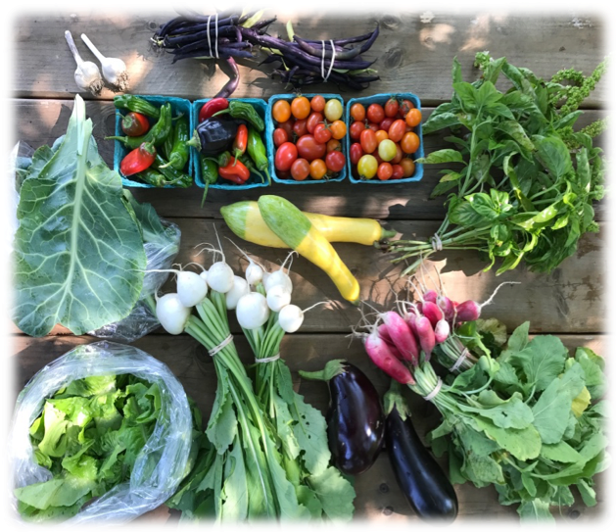
CSA historical development
CSA evolved separately and simultaneously in
different countries:
  1960’s → It emerged in Japan
  1970’s → It grew steadily in Europa
  1980’s-1990’s → It expanded in North America
It emerged due to the growing dissatisfaction regarding the negative impact of mechanized and chemically intensive agriculture, the sale of unsafe food, and the urbanization of farmland

Slide 6
INTRODUCTION
CSA Motivations and Expectations
Economic, financial, management practices:
  farmers are ensured a steady and fair market regardless of seasonal or weather fluctuations (upfront payment and sharing of risks and benefits)
  members benefit by receiving regularly a full share of fresh produce
Environmental factors:
  low/no use of inputs, maintaining biodiversity, adopting traditional farming practices, reducing food miles, increasing seasonal eating
Social, cultural, and community aspect:
  farms rely on core groups of volunteers to oversee operational aspects
  farms call on members to help with weeding or harvesting
  farms do not require to work on the farm but emphasize the community aspect at produce share pick up

Slide 7
INTRODUCTION
CSA Motivations and Expectations
Other key aspects:
  quality and quantity of the produce share adjusted to the preferences of the customers.
  promotion of a healthy diet
  accessibility of food to low-income communities
  commitment based on professional and personal values and skills

Slide 8
RESEARCH OBJECTIVES
Past research concentrated on CSA members’ motivations
Need to gain a better understanding of CSA farmers’ benefits and drawbacks in managing a CSA farm
The literature on the CSA is mostly focused on North America and Western Europe
Research gap on the cross-analysis of the managerial driving forces of CSA farmers coming from different countries
This research objectives address two main questions:
  what are the perceived motivating benefits and drawbacks of CSA farming management?
  are there differences and similarities between the perceptions of CSA farmers based in US and HU?

Slide 9
MATERIALS AND METHODS
Data collection:
  35 farmers based in the United States (21) and Hungary (14)
  face-to-face, telephone and on-line interviews with Qualtrics support
  On-site hosting of researchers to ensure data collection
  Participants’ profile:
    US participants (compared to HU participants) are younger, have children in the household, higher yearly income and higher level of education
    in both countries:
    - female farmers participated more than male farmers
    - farmers’ CSA experience is well distributed (from 1 year to more than 10 years)
    - farmers are mostly in favour of renewing their CSA farming experience for the following years

Slide 10
MATERIALS AND METHODS
Questionnaire Structure
  extensive literature review to identify questionnaire’s items
  the items were fine-tuned and clustered into 12 categories
  a Likert scale from 1 (strongly disagree) to 5 (strongly agree)
  the questionnaire was tested in Italy, US and HU.
DRAWBACKS
PRODUCT CHARACTERISTICS
MANAGEMENT OF CSA NETWORK
MANAGEMENT OF FARM
MANAGEMENT due to ENVIRONMENTAL CHALLENGES
BENEFITS
PRODUCT CHARACTERISTICS
ECONOMIC AND FINANCIAL
HEALTH AND NUTRITION
COMMUNITY
ENVIRONMENTAL
EMOTIONAL
FARM LIFE
MANAGEMENT

Slide 11
MATERIALS AND METHODS
Sample characteristics
  35 farmers based in the United States (21) and Hungary (14)
  face-to-face, telephone and on-line interviews in 2018 with Qualtrics support
  on-site hosting of researchers to ensure data collection
 |  | Country (%) |  | Total (%)
 |  | US | HU
Gender | Male | 33.3 | 46.2 | 38.2
 | Female | 66.7 | 53.8 | 61.8
 | Total | 100.0 | 100.0 | 100.0
Level of education | High school | 4.8 |  | 2.9
 | Some college | 14.3 | 38.5 | 23.5
 | Bachelor’s degree | 61.9 | 15.4 | 44.1
 | Postgrad. degree | 19.0 | 46.2 | 29.4
 | Total | 100.0 | 100.0 | 100.0
Work condition | Full time | 95.2 | 84.6 | 91.2
 | Part time |  | 15.4 | 5.9
 | Student | 4.8 |  | 2.9
 | Total | 100.0 | 100.0 | 100.0
    farmers’ CSA experience is well distributed (1 year - 10 years)
    farmers tend to renew their CSA farming experience for the following years

Slide 12
DATA ELABORATION
  Data Elaboration
  Step 1 → Anova Test
  Step 2 → Average values of constructs’ items
  Step 3 → Principal Component Analysis (with convergent and discriminant analysis) on perceived benefits and drawbacks
  Software: SPSS Statistics

Slide 13
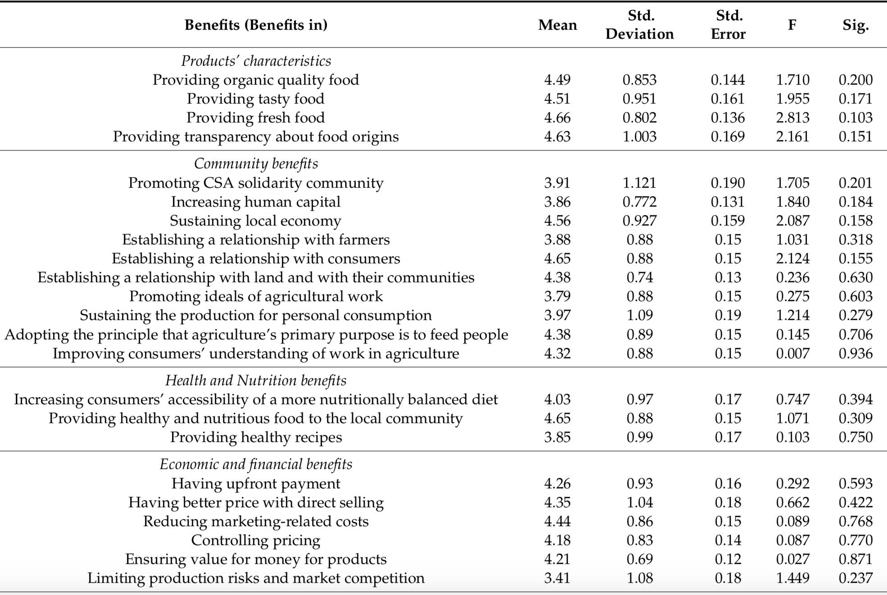
RESULTS CSA farmers’ perceptions on benefit items

Slide 14
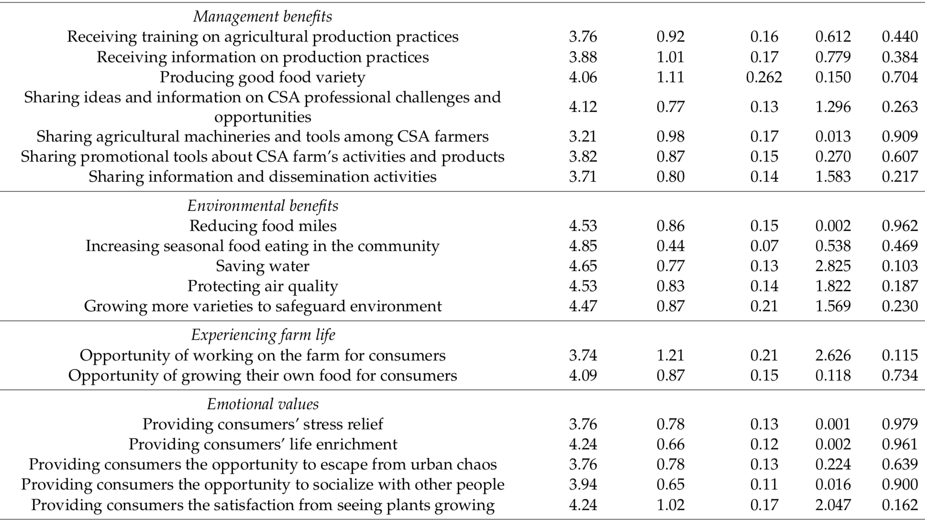

Slide 15
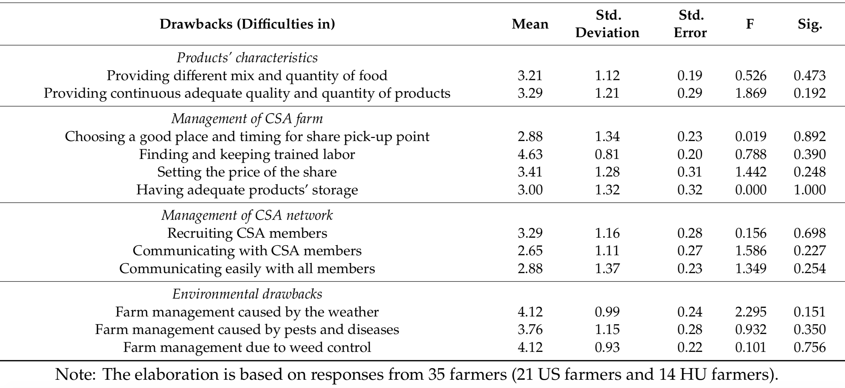
CSA farmers’ perceptions on drawback items

Slide 16
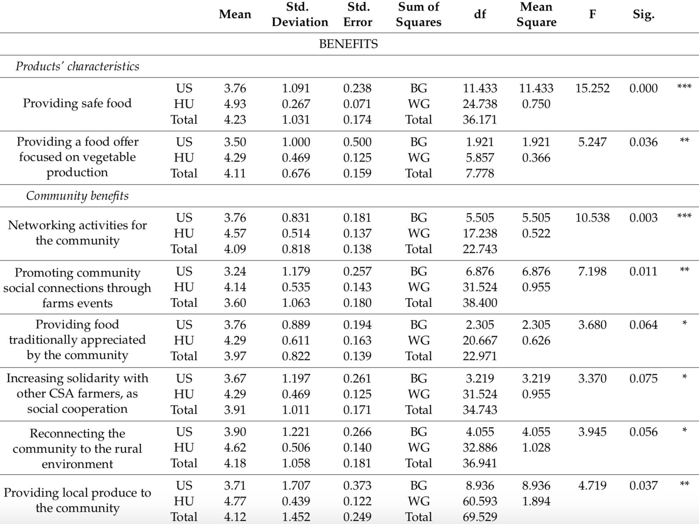
CSA farmers’ perceptions on management benefits and drawback items with significant one-way ANOVA (US and HU farmers)

Slide 17
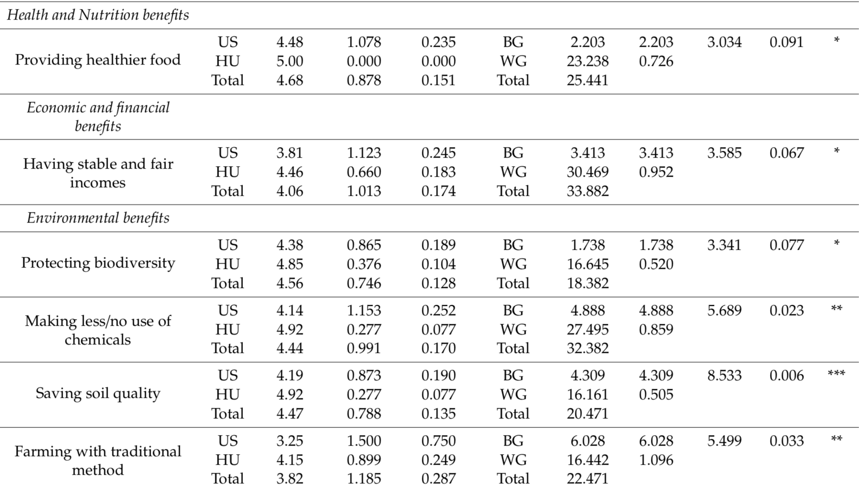
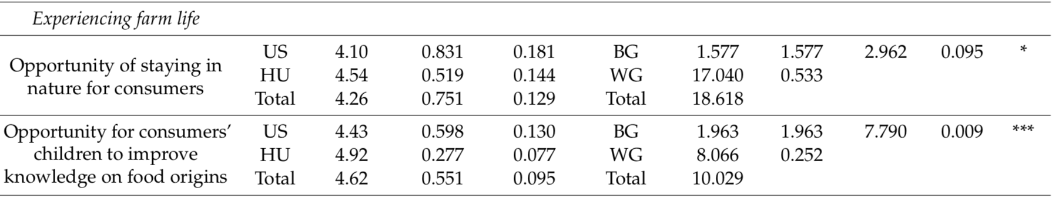
CSA farmers’ perceptions on management benefits items
with significant one-way ANOVA (US and HU farmers)

Slide 18
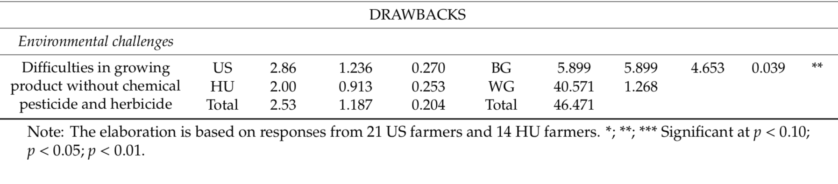
CSA farmers’ perceptions on management drawback items
with significant one-way ANOVA (US and HU farmers)

Slide 19
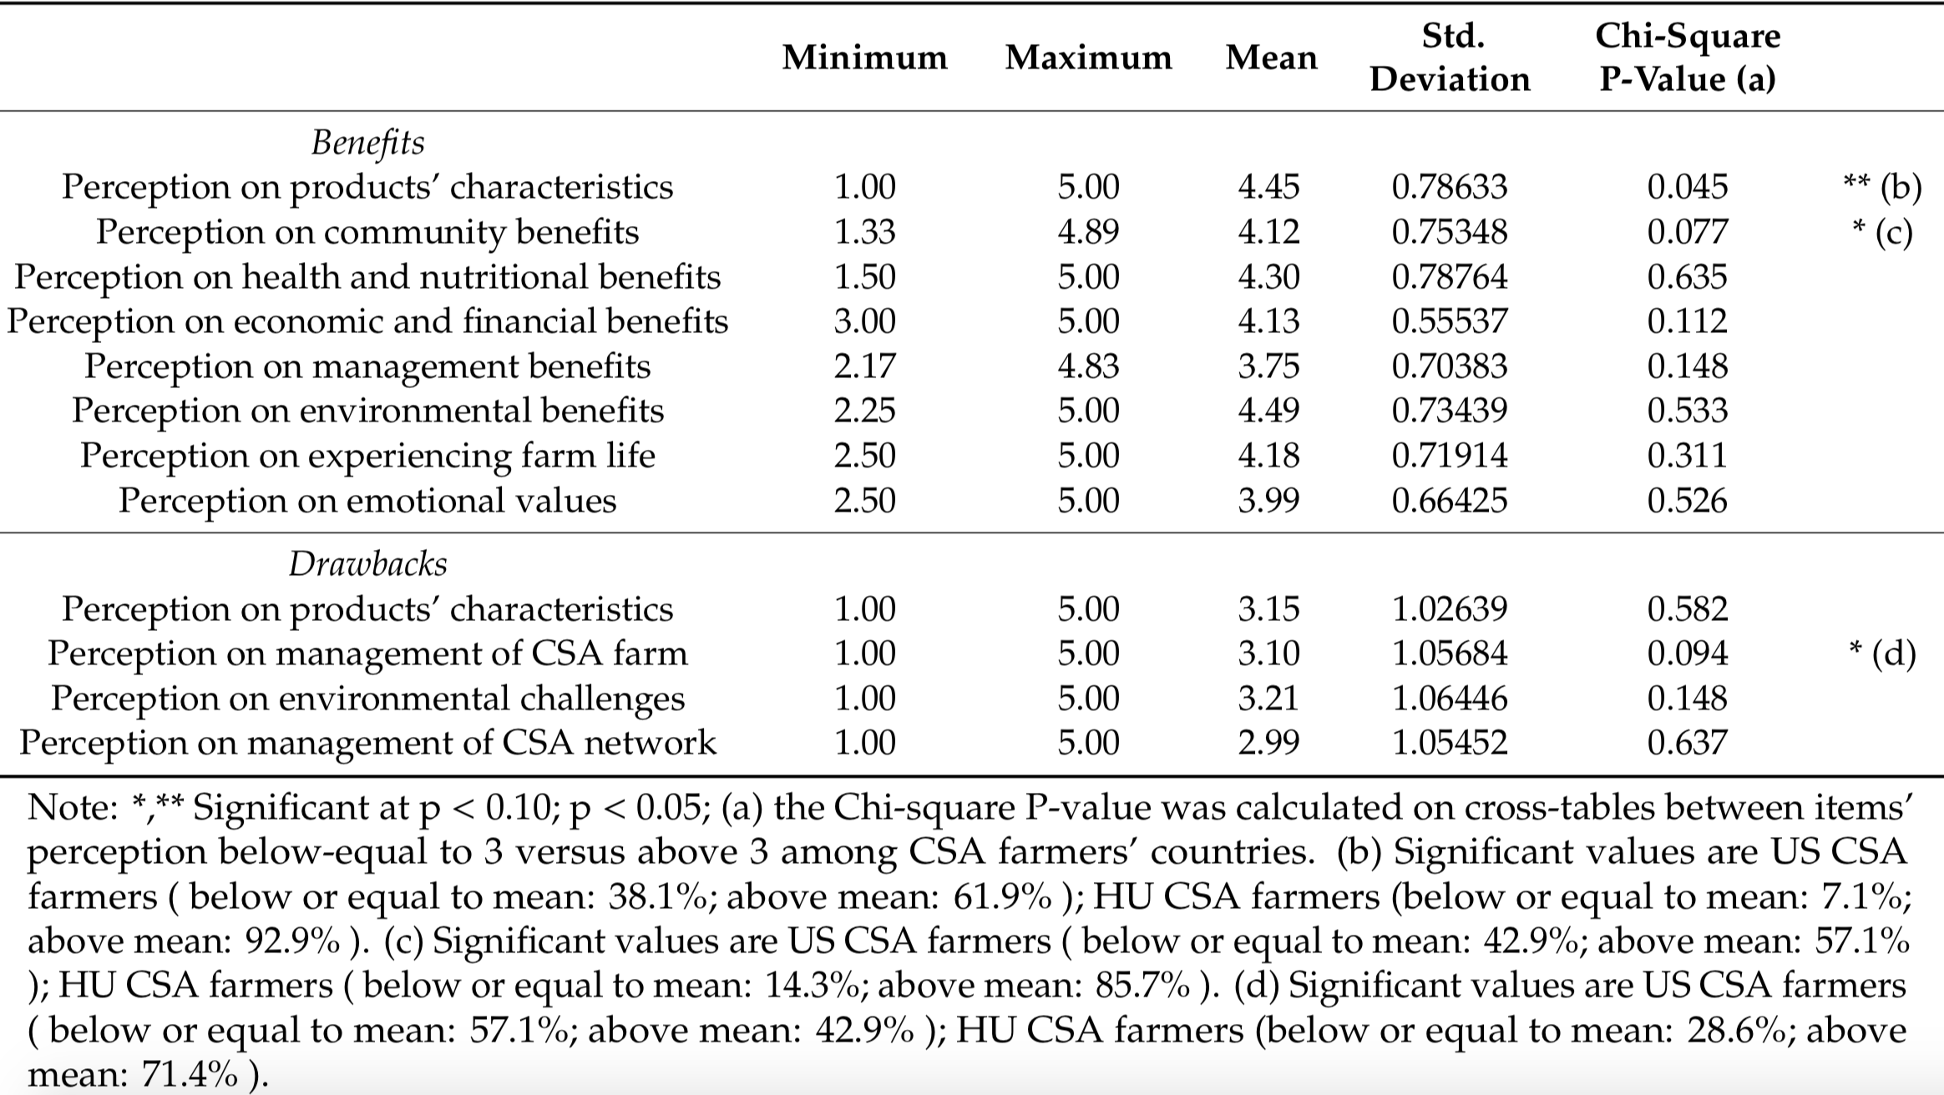
Perception on benefits and drawbacks constructs (all farmers) and chi-square by Hungary (HU) and United States (US) countries

Slide 20
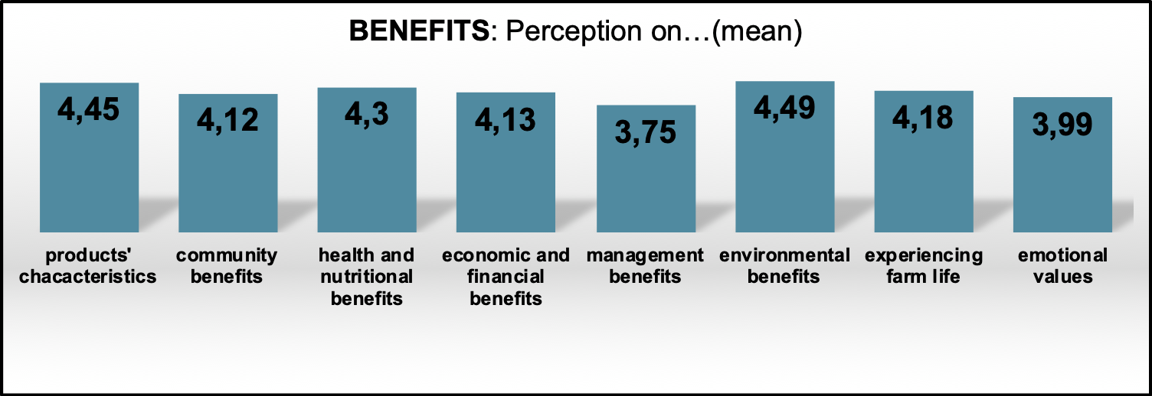
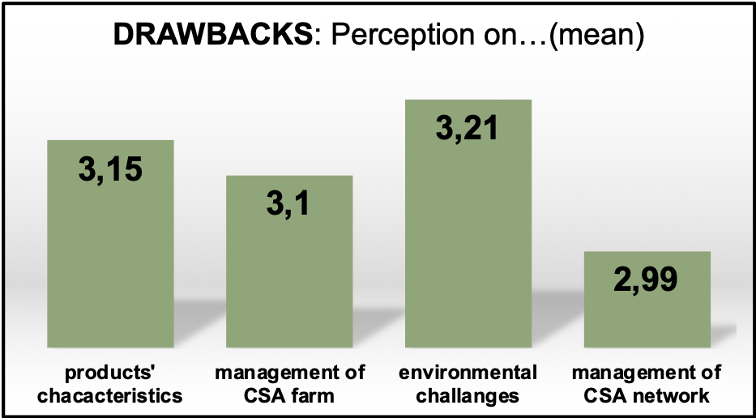
Perception on
benefits and drawbacks constructs

Slide 21
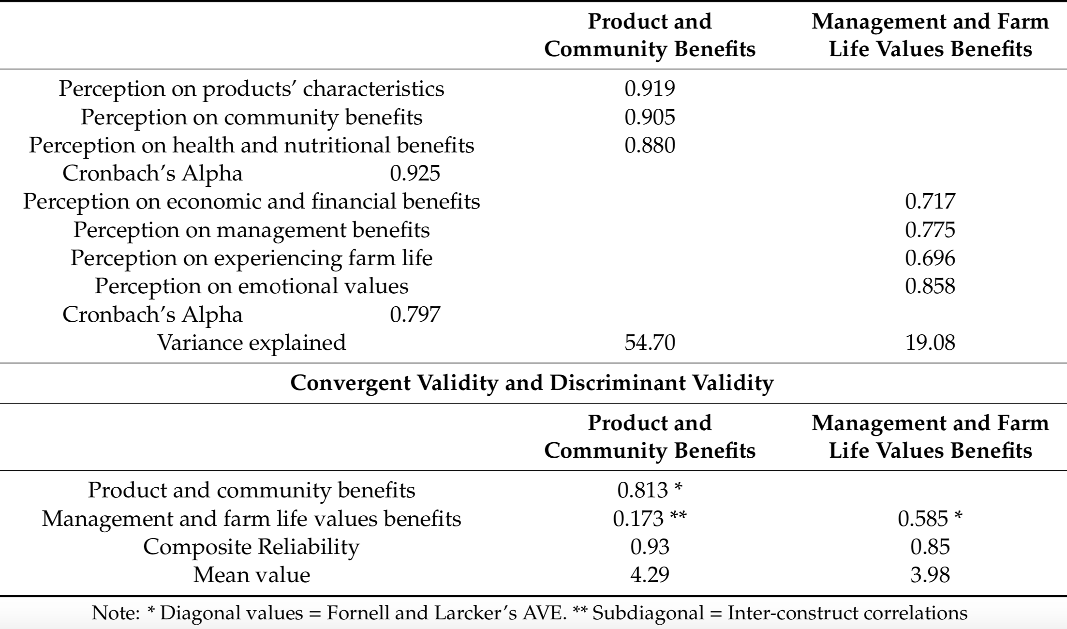
Factor analysis on benefits in CSA farming and convergent validity and discriminant validity for each construct

Slide 22
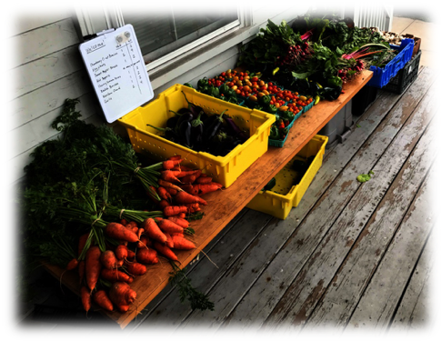

DISCUSSION
Personal, social, environmental, and economic driving forces motivate CSA farmers:
  HU farmers treasure the product, community, and environmental benefits of CSA farming
  US farmers give importance to the economic dimension. Higher concern on the possible difficulties by not using chemical inputs
  Managerial aspects are perceived similarly among US and HU farmers. Difficulties in managing from an economic, management and financial perspective.
  Satisfaction of members, but turnover rates are often high (50%)
  CSA farming management requires careful logistics management

Slide 23
DISCUSSION
The higher accessibility to sustainable and healthy food provided by conventional sales channel increasingly challenges the CSA concept
CSA farmers should:
  invest in communication, provide information and organize social and cultural events
  improve the skills and extend the machineries to manage surplus production
  increase awareness of the species and varieties that are well-established and popular in the region
  There is need to identify CSA management approaches that ensure farmers’ income

Slide 24

CONCLUSIONS
The present study:
  confirms that non-monetary benefits are the essential backbone of CSA farming, but monetary benefits are to be ensured for CSA long-term perspective and upscale
  shows that there are significant similarities through countries
    Further analysis may focus on:
      understanding the factors that lead farmers to enter (or to exit) from CSA farming
      identifying the benefits and barriers to fully exploit the farmers’ CSA networks and associations

Slide 25
Antonella Samoggia
Dipartimento di Scienze e Tecnologie Agro – Alimentari
UNIVERSITÀ DI BOLOGNA
antonella.samoggia@unibo.it

