Slide 1
Role of Rectors’ Committee in
Higher Education Reform
Dr Zaw Wai Soe,
Rectors’ Committee
National Education Policy Commission, Myanmar

Slide 2
Laws
National Education Law (2014)
Amended National Education Law (2015)
National Education Strategic Plan (2016-2021)
Amended National Education Law (2015)
The Commission can form an independent committee
composed of appropriate people to cooperate and negotiate on the matters related to Higher Education without interfering with the autonomy of the universities.
Rectors’ committee?
Without interfering with
the Autonomy of the Universities

Slide 3
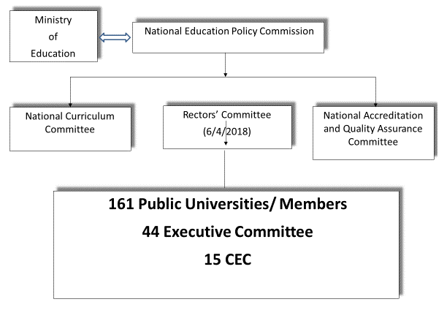
National Education Law

Slide 4
Rectors’ Committee
Their History
6 April 2018
Election on 12 March 2018 by National Education Policy Commission
On 23/8/2018, formation of 8 Groups of Related Universities and of 9 working committees

Slide 5
Rectors’ Committee
Their Purpose
Duties and responsibilities:
to coordinate, cooperate, and negotiate
but not to administrate
without intervening the autonomy of the universities
Autonomy (Administrative, Academic, Staffing, and Financial)
Their Activities
Charter
Teacher Union
Student Union
Research and Publication
International Relations

Slide 6
State Counsellor
To meet Life long learning and Career aspiration of our students.
Quality, Equitable and Relevant Education is essential

Slide 7
State Counsellor
Education plays a central role in reducing poverty and inequity, increasing household incomes, improving individual and family health, strengthening our communities, fostering lasting peace, expanding economic development and building national unity.
Developing a world-class, higher education system, with a strong focus on research and innovation, to meet the country’s social and economic development needs.

Slide 8
Union Minister
The purpose of Myanmar’s National Education System is to equip our students, youth and adult learners with the knowledge and skills they need to succeed in the 21st century.
Through working together over the next five years, we can achieve a great deal to transform Myanmar’s Education System with greater efficiency, effectiveness and transparency in order to substantially raise the learning standards for all.

Slide 9
Challenges
The traditional centralised model of governance, leadership, and management is progressively being updated to a more corporate model.
HEIs need to take greater responsibility and accountability
The capacity of senior HEI officials, administrative managers, and academics needs to be strengthened.
Governance and management of higher education
Quality
Equitable access
Research development at higher education institutions

Slide 10
3 Strategies for HE
Strengthen HE governance and management capacity
Improve the quality and relevance of HE
Expand equitable access to HE

Slide 11
Strategy 1
Undertake overseas study tours to document best practices and establish partnerships
Establish a National Institute for Higher Education Development (NIHED)
Strengthen governance of HEIs through university charters and university councils
Strengthen autonomy and accountability of HEIs
Establish a Higher Education Quality Assurance Agency (HEQAA)

Slide 12
Strategy 2
Establish a National Research and Innovation Fund and Research and Development Centres at HEIs
Develop a policy and strategy for world-class national universities and comprehensive universities
Upgrade facilities at selected HEIs
Enhance the status of e-learning centres and e-libraries
Improve the effectiveness of the distance education system
Undertake professional development for faculty and laboratory technicians

Slide 13
Strategy 3
Create a good teaching and learning environment at HEIs
Promote student support programmes

Slide 14
Annual Conference (2018)
Approved 3 monthly report
Approved the RC’s Constitution
Approved to propose on SOPs & Guidelines for MoU, MoA, LoA, LoI
To upgrade research capacity & to conduct applied research in Universities
To propose to have Financial Autonomy accordingly with NEL
To find the ways to Uni Autonomy within current framework
General Discussions and Decisions.

Slide 15
General Decisions
University Set Up and Organogram
University Charter and Unions
Educational Science for faculty development

Slide 16
Thank You

