Slide 1


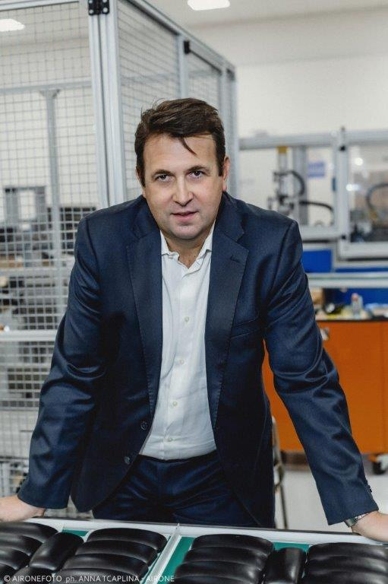
CRISTIAN
PARAVANO
BIO:
  49 years old – two children.
  Degree In Computer Science – 1996.
  Master MBA – 2006.
  Master BBS MBA Sustainability & Innovation – 2020
  Many labor experiences in consultancy and manufacturing multinational companies as ICT/Organization field.
  Director since 2001 starting from consultancy to logistic and manufacturing companies.
  Gatto Group Since 2008 with different roles. Currently Group Operations Director.
PEOPLE

Slide 2
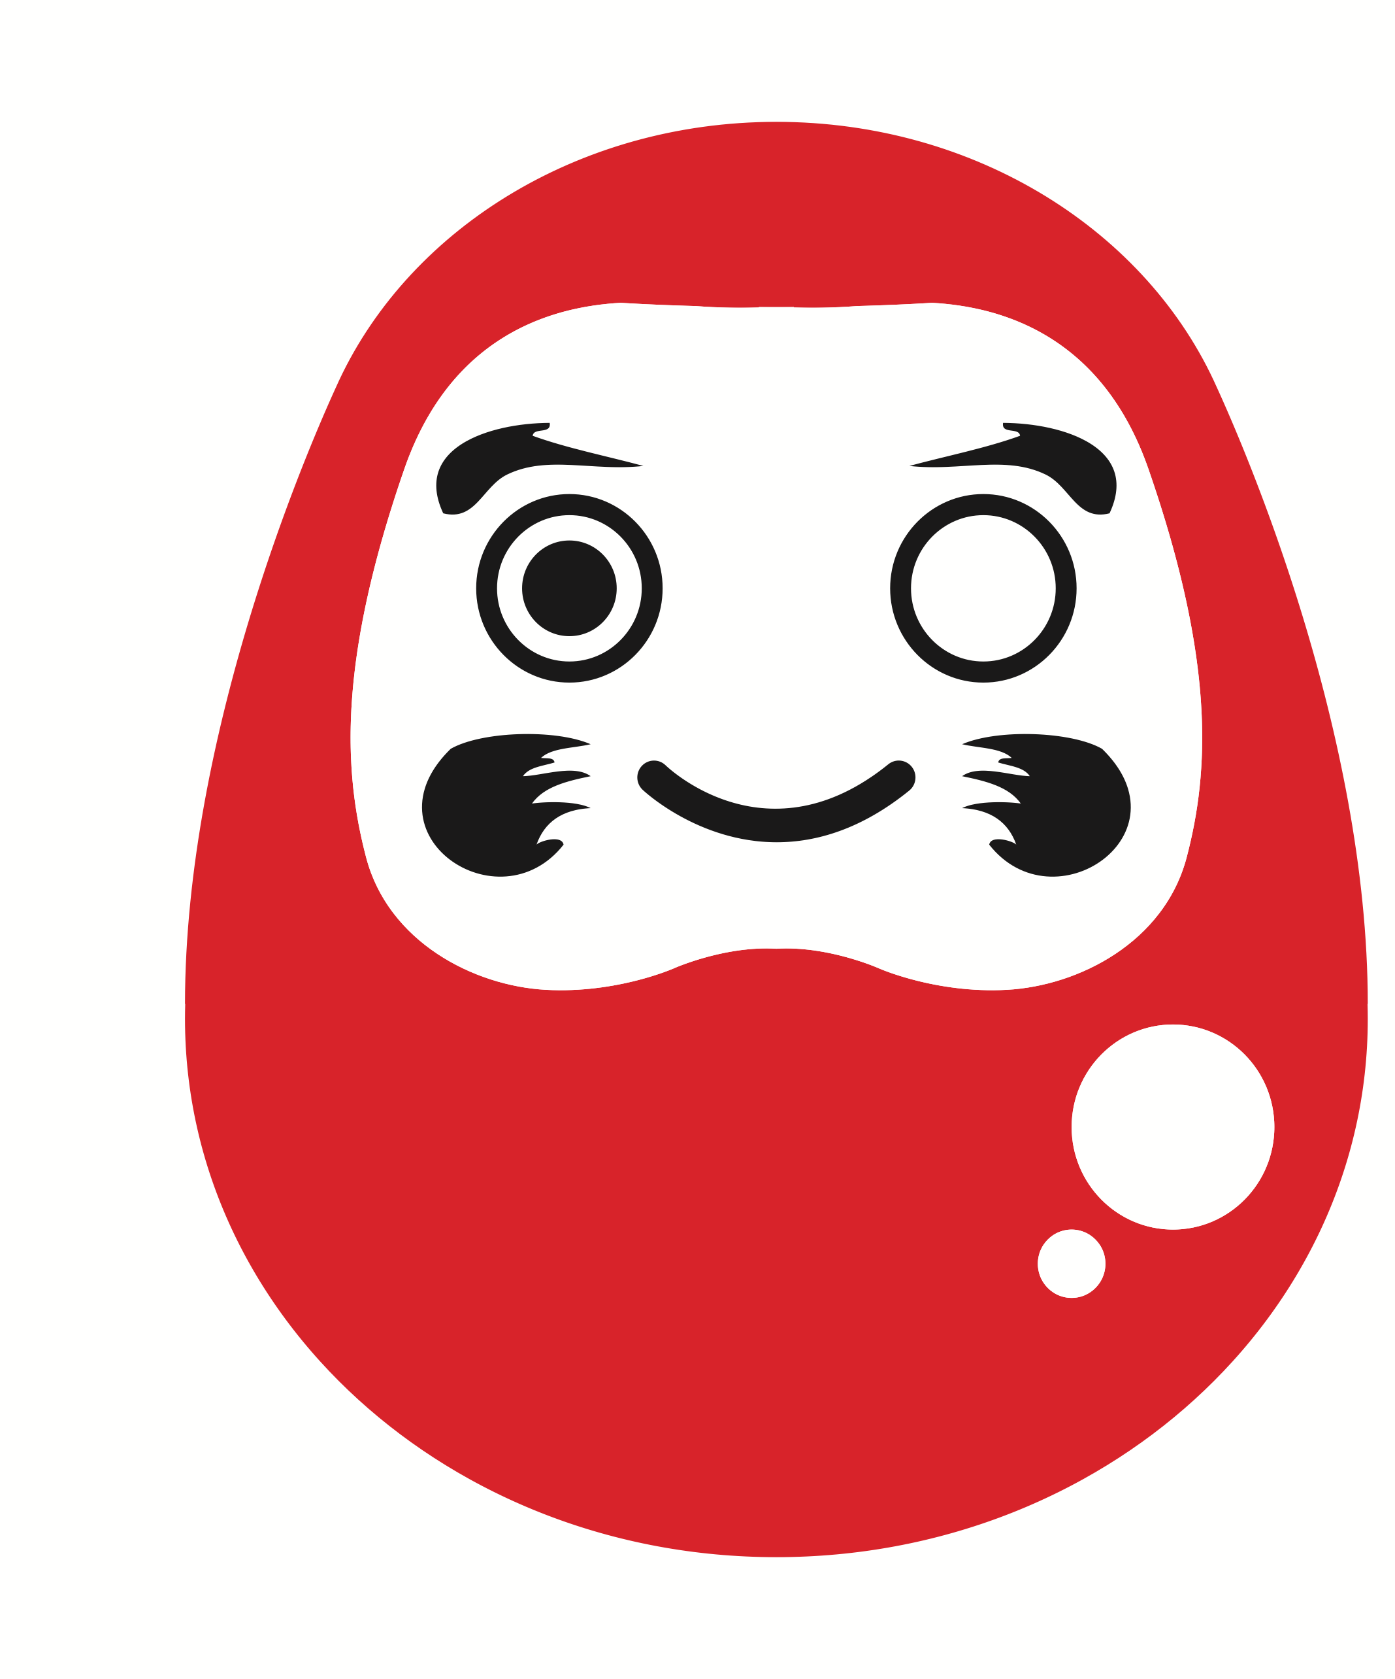
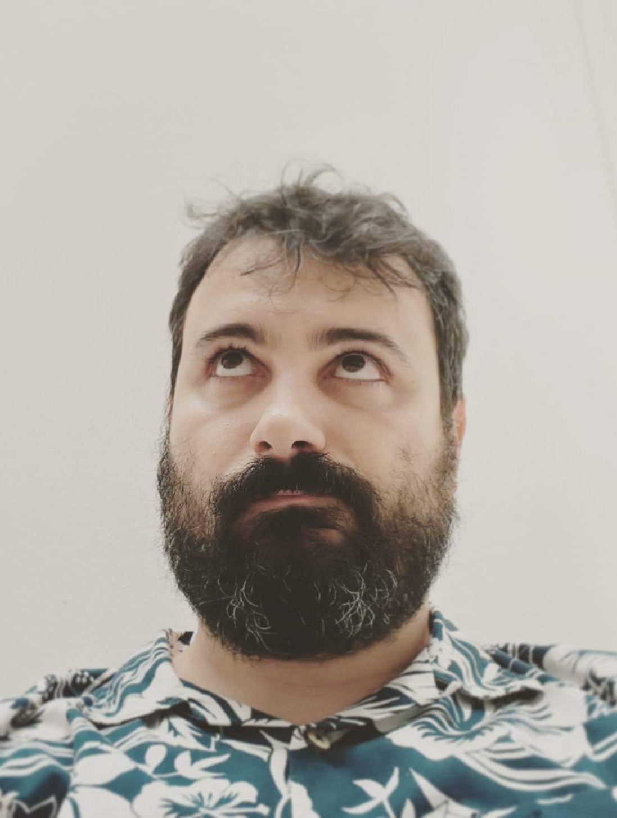
Francesco Fullone
business & sustainability designer
https://linkedin.com/in/fullo
FRANCESCO
FULLONE
PEOPLE
BIO:
  43 years old – two children.
  Degree In Computer Science – 2003.
  Master BBS MBA Sustainability & Innovation – 2020
  Entrepreneur in ITC since 1999, Startup advisor and investor since 2008
  Public speaker and IT Conference Organizer
  Currently Founder Institute’s Director and Freelance consultant in Business and Sustainability Design

Slide 3

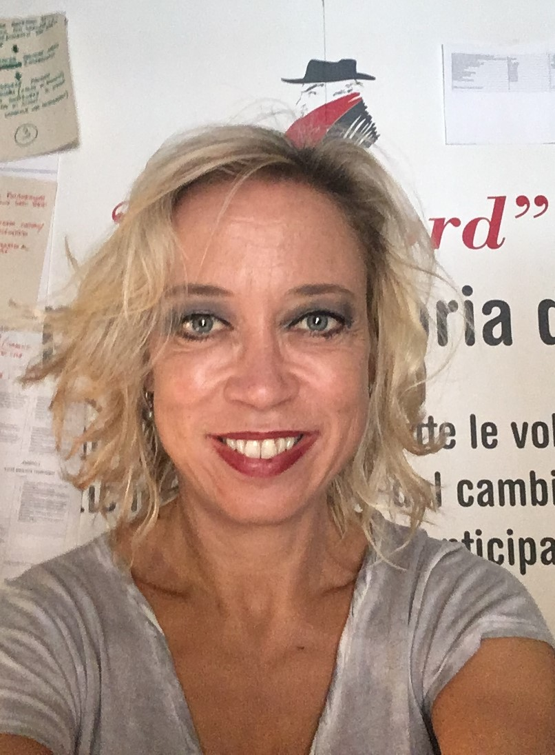
VALENTINA
RIDOLFI
BIO:
  51 years old
  Degree in Art and Literature – 1997
  Master in EU project and financial management, Venice University – 2006
  Master in Sustainability and Business Innovation BBS - 2020
  Since 2001 Executive Responsible within consulting companies working for Public and Private Sector in the field of town and territorial planning and development
  Since 2013, Coordinator at Rimini Strategic Plan Agency
  Since 2018, Board Member at Italian Exhibition Group spa and, since 2020, Board Member at UniRimini spa
PEOPLE

Slide 4

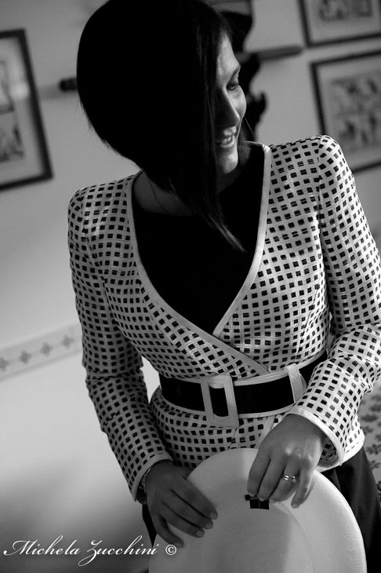
GIORGIA
STANCARI
PEOPLE
BIO:
  41 years old – two children.
  Degree In Management and Engineering – 2004.
  Master BBS MBA for Business Innovation Design – 2020.
  2004 Ferrari spa, Project Manager
  Gruppo HERA since 2005, Environmental Services.
  Actually Processes and Digital Innovation Manager for the Environmental Services Business Unit.

Slide 5

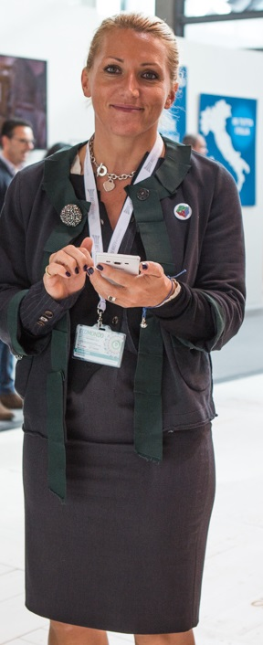
LINDA BOTTA
PEOPLE
BIO:
  44 years old.
  Degree In Mathematics - 2000.
  Master MBA – 2005.
  2000-2005 consultant in the telecommunication market: CRM and web capabilities.
  2006-2012 Brand Manager in FMCG market.
  2012-2018 HERAmbiente Head of Marketing.
  2018 Aliplast Head of Operations.

Slide 6

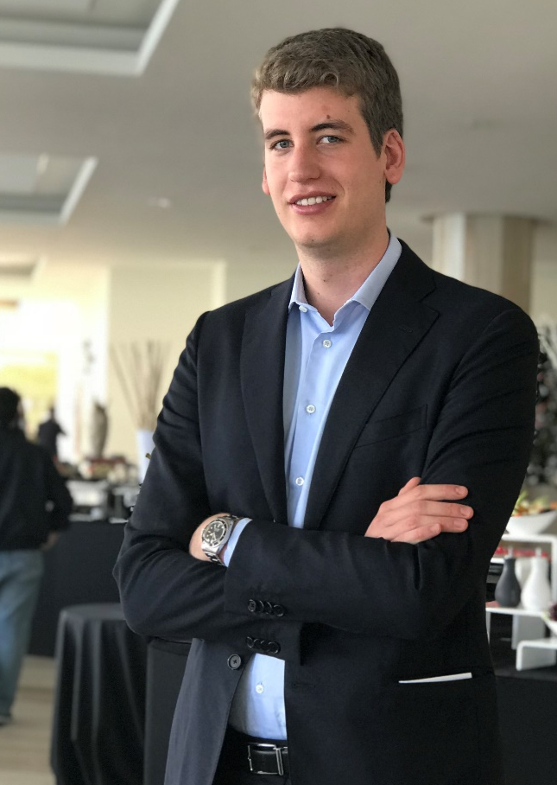
ALESSANDRO
FIER
PEOPLE
BIO:
  27 years old
  Degree In Economics – 2015.
  Master In Entrepreneurship – 2019.
  Previous experience in strategy consulting, focus on FMCG and retail
  Joined Rougj in 2017, currently Deputy Marketing Director and Country Manager France

Slide 7


FLAVIANO
CELASCHI
BIO:
Professore ordinario di Disegno industriale all'Università di Bologna.
Cofondatore e primo direttore del Dipartimento di Design del Politecnico di Milano e del consorzio di ricerca POLI.design.
Tra il 2004 e il 2008 ha insegnato al Politecnico di Torino dove è stato Pro-Rettore.
Dal 2004 si occupa d'internazionalizzazione del design. Ha insegnato e fatto ricerca in Brasile, Messico, Repubblica Popolare Cinese, Argentina, India, Stati Uniti.
Nel 2008 ha fondato la Rete Latina del Design dei Processi, organizzazione che raduna oltre 50 professori e ricercatori di università europee e americane.
Si occupa d'innovazione trainata dal design e d'innovazione dei processi creativi.
PEOPLE

Slide 8
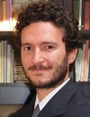
MATTEO
MURA
BIO:
PhD, è Professore Associato in Ingegneria Economico-Gestionale presso il Dipartimento di Scienze Aziendali dell’Università di Bologna, Visiting Fellow presso il Centre for Business Performance della Cranfield School of Management e Teaching Associate presso la Warwick Business School.
E’ Direttore del Global MBA in Green Energy and Sustainable Business e dell’Executive Master in Sustainability and Business Innovation presso Bologna Business School.
La sua attività di ricerca si focalizza su transizione industriale verso la sostenibilità e sullo sviluppo di metriche per la misurazione della sostenibilità nelle imprese.
Collabora con centri di ricerca in UK, Svizzera e Brasile e coordina progetti di ricerca finanziati dall’Unione Europea e da importanti gruppi aziendali italiani.
PEOPLE

